Slide 1
Brownian motion and Gambler’s ruin
By
Dewansh Dikshit (21060641015)
Hemangi Bachhav (21060641019)
Mansi Kale (21060641026)
Shivesh Shukla (21060641046)

Slide 2
Stochastic Process
A stochastic process is defined as a collection of random variables X={Xt:t∈T} defined on a common probability space, taking values in a common set S (the state space), and indexed by a set T, often either N or
[0, ∞) and thought of as time (discrete or continuous respectively)

Slide 3
Brownian Motion (Wiener Process)
Brownian motion is another widely-used random process. It has been used in engineering, finance, and physical sciences. It is a Gaussian random process and it has been used to model motion of particles suspended in a fluid, percentage changes in the stock prices, integrated white noise, etc.
A real-valued stochastic process {W(t) : t ≥ 0} is called a (linear) Brownian Motion with started in x ∈ R if the following holds:
(i) W(0) = x
(ii) the process has independent increment, i.e. for all time 0 ≤ t1 ≤ t2 ≤ ... ≤ tn the increments W(tn) − W(tn−1), ... ,W(t2) − W(t1) are independent random variables.
(iii) for all t ≥ 0 and h > 0, the increments W(t + h) − W(t) are normally distributed with expectation zero and variance h
(iv) the function t → W(t) is continuous
In addition, we say that {W(t) : t ≥ 0} is a standard Brownian Motion if x=0

Slide 4
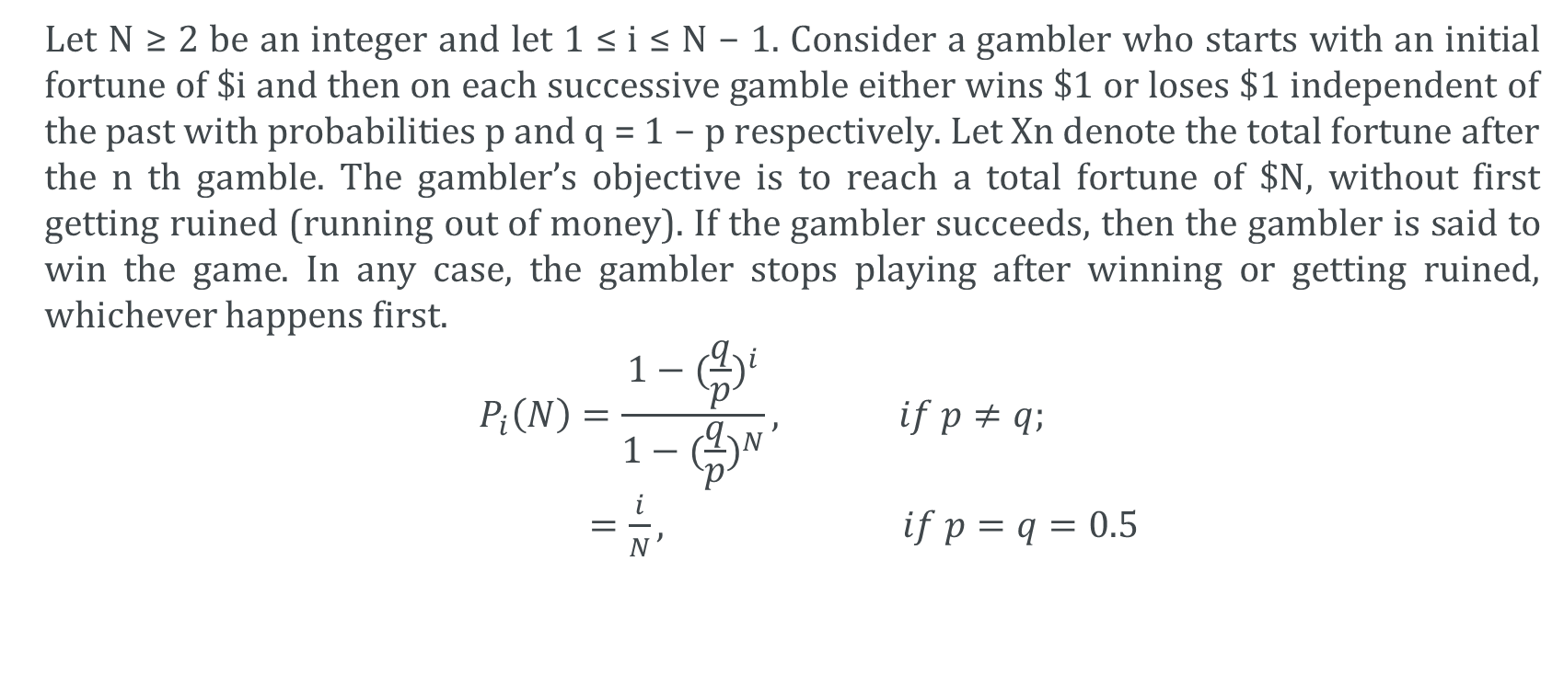
Gambler’s Ruin Problem
Let N ≥ 2 be an integer and let 1 ≤ i ≤ N − 1. Consider a gambler who starts with an initial fortune of $i and then on each successive gamble either wins $1 or loses $1 independent of the past with probabilities p and q = 1 − p respectively. Let Xn denote the total fortune after the n th gamble. The gambler’s objective is to reach a total fortune of $N, without first getting ruined (running out of money). If the gambler succeeds, then the gambler is said to win the game. In any case, the gambler stops playing after winning or getting ruined, whichever happens first.
$$P_{i}\left(N\right)=\frac{1−{(\frac{q}{p})}^{i}}{1−{(\frac{q}{p})}^{N}}, if p≠q;$$
$=\frac{i}{N}, if p=q=0.5$

Slide 5

I.]
i=5, p=0.3, q=0.7, n=10
r$=\frac{1−p}{p}=1.5$
i=0, a_{i}=0
i=0, a_{i}=1
a_{i}=pa_{i+1}+(1-p)a_{i-1}
a_{i}=$\frac{1−r^{i}}{1−r^{n}}=0.0142521$
a_{i} = Probability of winning $10
$C_{2}=\frac{n}{(q−p)(1−{\left(\frac{q}{p}\right)}^{n})}=−0.005227125$
$C_{1}=−C_{2}=0.005227125$
$M_{i}=C_{1}+C_{2}{(\frac{q}{p})}^{i}+\frac{i}{q−p}=13.98$
${ M}_{i}=Expected duration of the game if A starts with i=5 dollars$

Slide 6

II.]
i=5, p=0.5, q=0.5, n=10
a_{i}=$\frac{i}{n}=\frac{1}{2}=0.5$
$M_{i}=i\left(n−i\right)=25$
III.]
i=5, p=0.6, q=0.4, n=10
a_{i}=$\frac{1−r^{i}}{1−r^{n}}=0.850971227$
$C_{2}=\frac{n}{(q−p)(1−{\left(\frac{q}{p}\right)}^{n})}=−50.88237829$
$C_{1}=−C_{2}=50.88237829$
$M_{i}=C_{1}+C_{2}{(\frac{q}{p})}^{i}+\frac{i}{q−p}=19.1818$

